Slide 1



COMPUTER GRAPHICS & MULTIMEDIA SYSTEMS SCS1302
UNIT IV – PART I

Slide 2
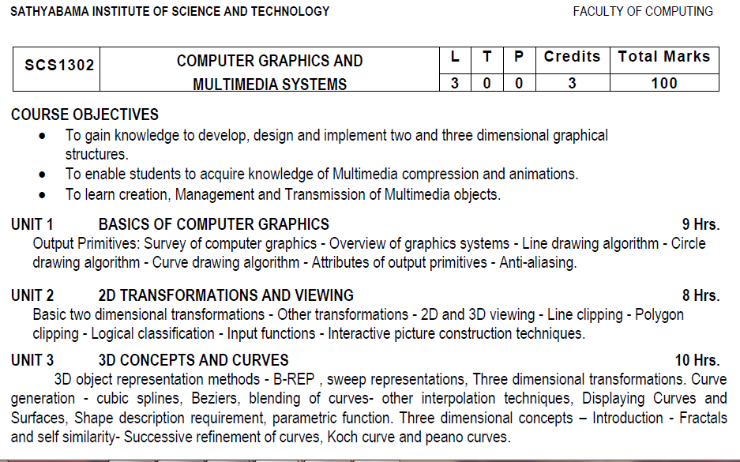
Syllabus

Slide 3
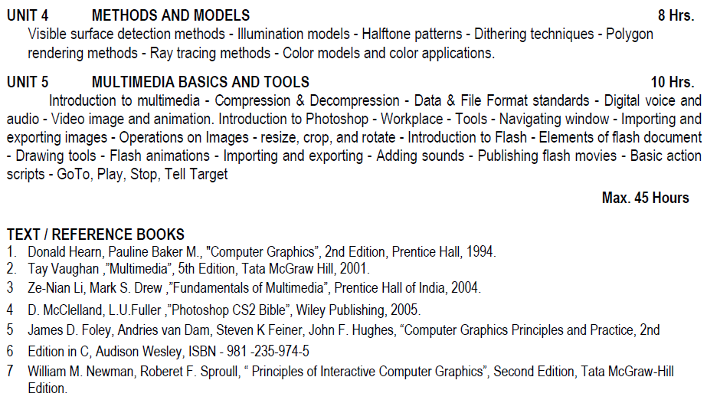
Syllabus

Slide 4
Course Objective(CO)
CO1: Construct lines and circles for the given input.
CO2: Apply 2D transformation techniques to transform the shapes to fit them as per the picture definition.
CO3: Construct splines, curves and perform 3D transformations
CO4: Apply colour and transformation techniques for various applications.
CO5: Analyse the fundamentals of animation, virtual reality, and underlying technologies.
CO6: Develop photo shop applications

Slide 5
UNIT - IV

Slide 6
Polygon Rendering Methods
Rendering of standard graphics objects-those formed with polygon surfaces

Slide 7
Flat surface rendering
Method works when
Polygon is one face of a polyhedron and is not a section of a curved-surface approximation mesh.
In this method, a single intensity is calculated for each polygon.
All points over the surface of the polygon are displayed with same intensity values.
All light sources illuminating the polygon are far enough away from surface that N.L and attenuation function are both constant over area of poly (diffuse)
Viewing position is far enough away from poly so that V . R is constant over area of poly (specular)

Slide 8
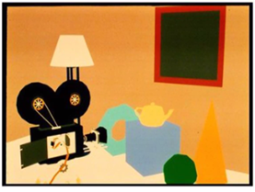

Slide 9
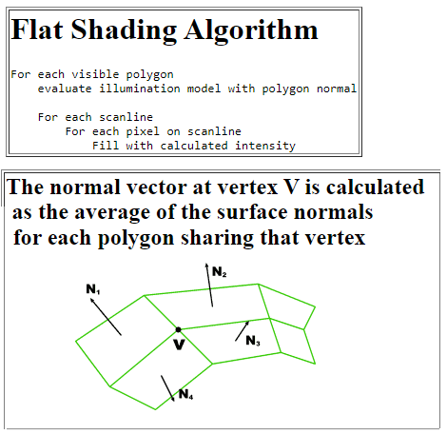
Flat surface rendering

Slide 10
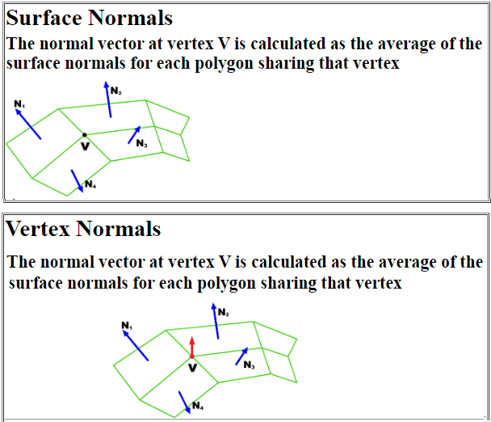
Flat surface rendering

Slide 11
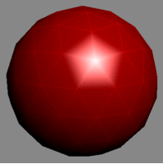
Flat surface rendering
One problem with flat surface rendering is that discontinuities arise on boundaries of polygons.

Slide 12
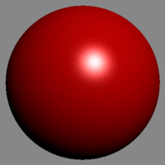
Gouraud Shading
A better algorithm, though still not perfect, is due to Henri Gouraud

Slide 13
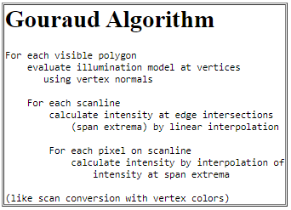
Gouraud Shading

Slide 14
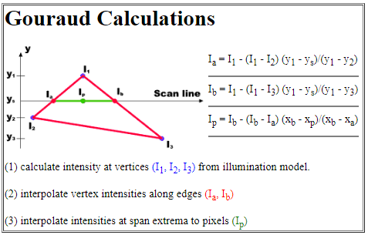

Slide 15
Gouraud (Interploated) Shading
Idea is to calculate intensity values at polygon vertices then, linearly interpolate these intensities across polygon faces of a lighted object.
Eliminates discontinuities that occur with flat shading.
Determine average unit normal vector at each vertex of poly. For a vertex v that is the meeting point for n polygons, each with normal Nk.

Slide 16
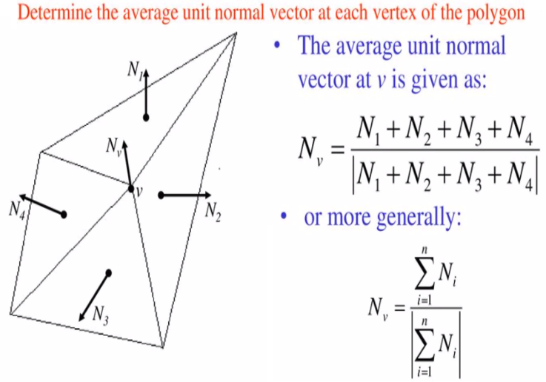

Slide 17
Gouraud Shading
Procedure
Determine average unit normal vector at each vertex of poly.
Apply illumination model at each vertex to obtain the light intensity at that position
Linearly interpolate the vertex intensities using scan lines over projected area of polygon.

Slide 18
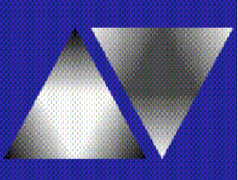
Gouraud Shading
Similar calculations are used to obtain intensities at successive horizontal pixel positions along each scan line.
Drawbacks:
Highlights displayed with anonymous shapes
Linear intensity interpolation can cause bright or dark intensity streaks called Mach bands.

Slide 19
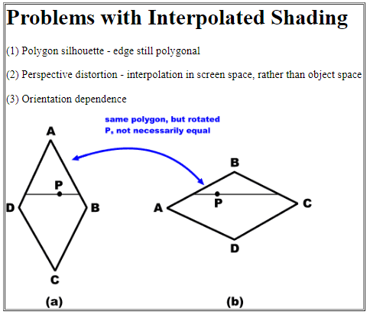

Slide 20
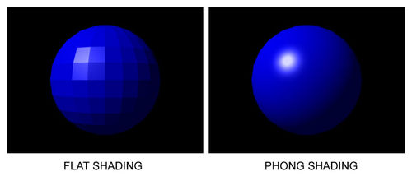
Phong Shading
Idea here is to interpolate the normal vectors instead of the light intensity.
Provides more accurate calculation of light intensity values and more realistic surface highlights.

Slide 21
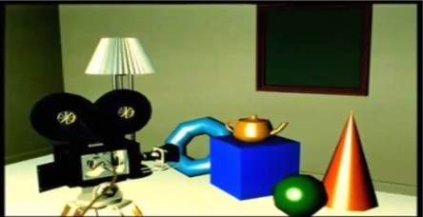
By Phong Bui Tong
Phong shading:
Handles specular highlights much better.
Does a better job in handling Mach bands.
But much more expensive than Gouraud shading.
Compute color per pixel.
Good for curved and shiny surfaces

Slide 22
Phong Shading
Procedure:
Find the average unit normal vector at each polygon vertex.
Linearly interpolate the vertex normals over the surface of the polygon.
Apply an illumination model along each scan line to calculate projected pixel intensities for the surface points.

Slide 23
Fast Phong shading
It is an enhanced Phong shading technique.
It approximates the intensity calculations using Taylor-series expansion and Triangular surface patches.

Slide 24
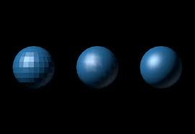
Comparison: Flat, Gouraud and Phong

Slide 25
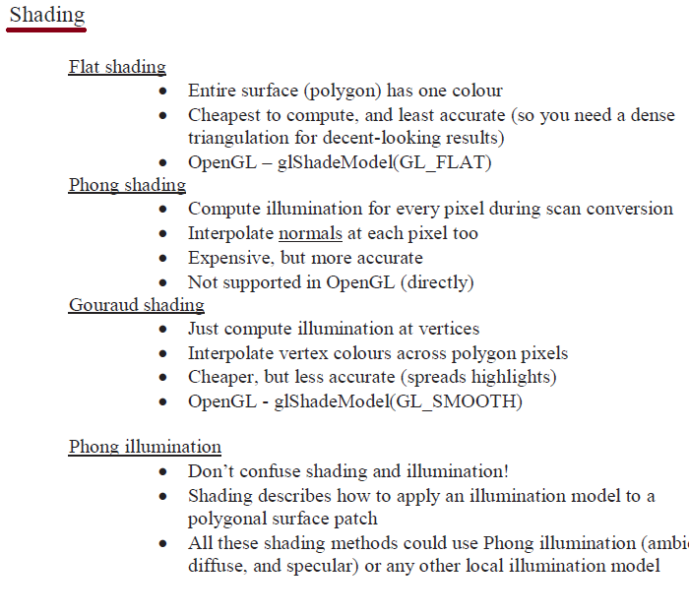
Polygon Rendering (Shading)

Slide 26
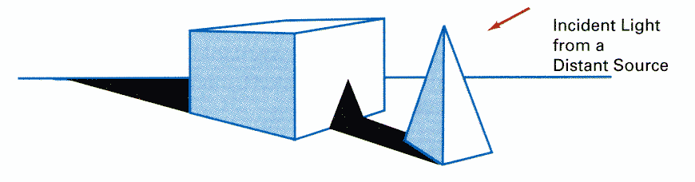
Other Effects: Shadow
Shadow can help to create realism. Without it, a cup, eg., on a table may look as if the cup is floating in the air above the table.
By applying hidden-surface methods with pretending that the position of a light source is the viewing position, we can find which surface sections cannot be "seen" from the light source => shadow areas.
We usually display shadow areas with ambient-light intensity only.

Slide 27
Ray-Tracing Methods
By using the Ray-casting, we can have a simple and powerful rendering technique for obtaining global reflection and transmission effects.
Refer the link for Ray Tracing notes:
http://math.hws.edu/graphicsbook/c8/s1.html

Slide 28
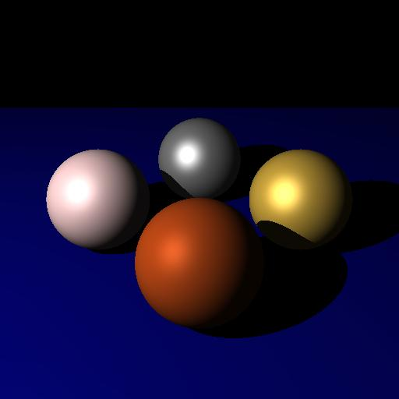
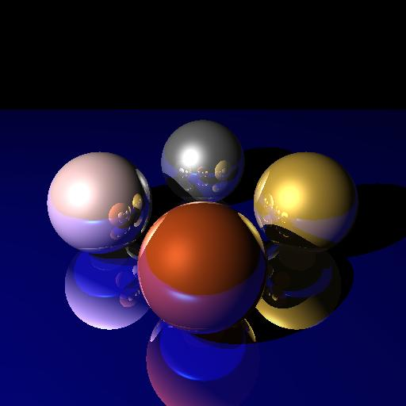
Photo-Realism
Created by David Derman – CISC 440

Slide 29
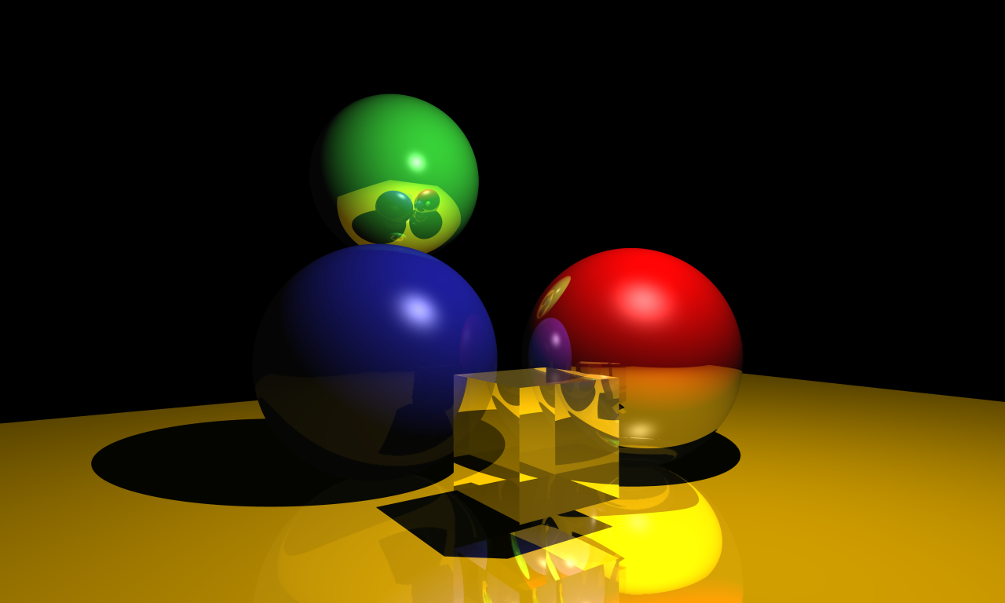
Created by Jan Oberlaender – CISC 640

Slide 30
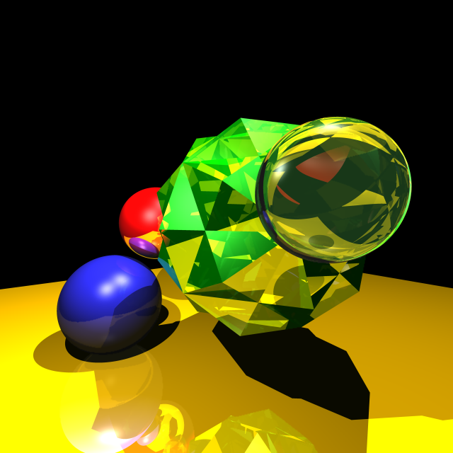
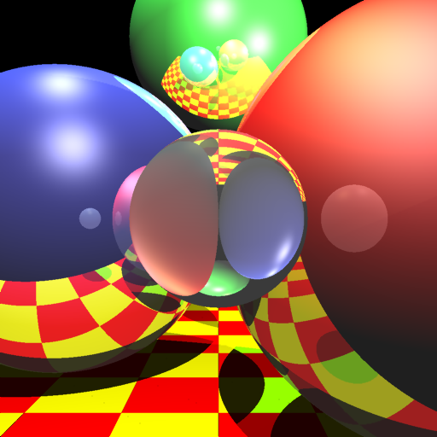
Created by Jan Oberlaender – CISC 640

Slide 31
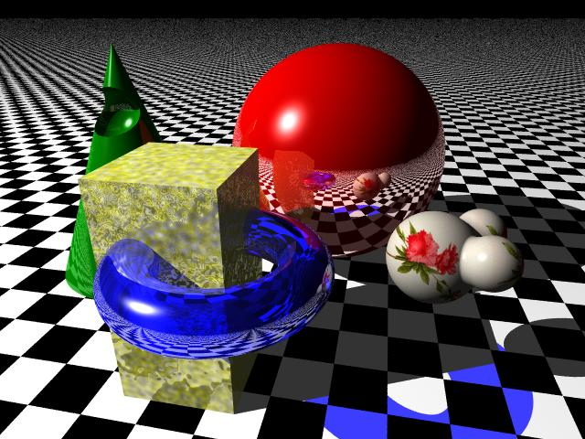
Created by Donald Hyatt
http://www.tjhsst.edu/~dhyatt/superap/povray.html

Slide 32
In ray tracing, a ray of light is traced in a backwards direction.
We start from the eye or camera and trace the ray through a pixel in the image plane into the scene and determine what it intersects
The pixel is then set to the color values returned by the ray.
If the ray misses all objects, then that pixel is shaded the background color

Slide 33
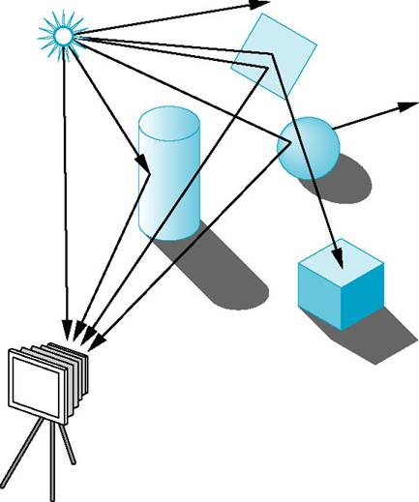
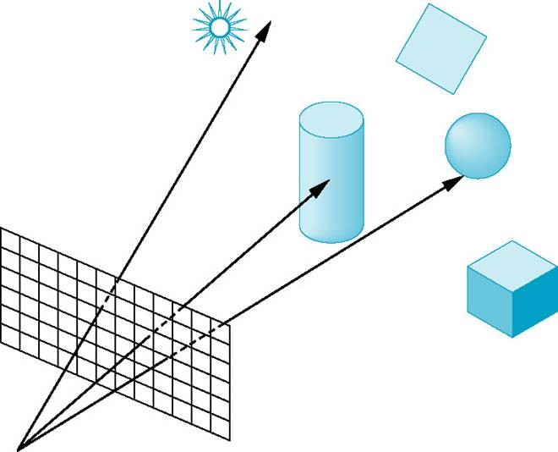
Overview
Forward Ray tracing
Rays from light source bounce of objects before reaching the camera
Computational wastage
Backward Ray tracing
Track only those rays that finally made it to the camera
Courtesy: Angel

Slide 34
Color Models

Slide 35
COLOR MODEL
Color Model- Method for explaining the properties or behavior of color within some particular context.
No single model can explain all aspects of color.

Slide 36
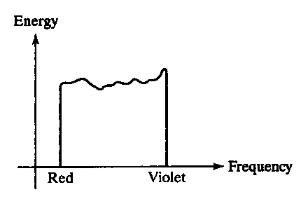
Physical properties of light
All kinds of light can be described by the energy of each wavelength
The distribution showing the relation between energy and wavelength (or frequency) is called energy spectrum

Slide 37
Physical properties of light
This distribution may indicate:
a dominant wavelength (or frequency) which is the color of the light (hue), cp. E_{D}
brightness (luminance), intensity of the light (value), cp. the area A
purity How pure the color of the light appears.

Slide 38
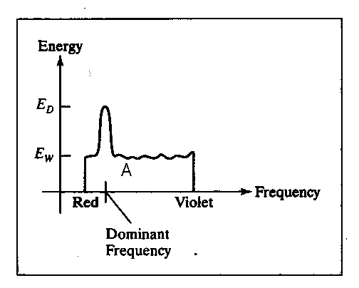
Physical properties of light
Energy spectrum for a light source with a dominant frequency near the red color

Slide 39
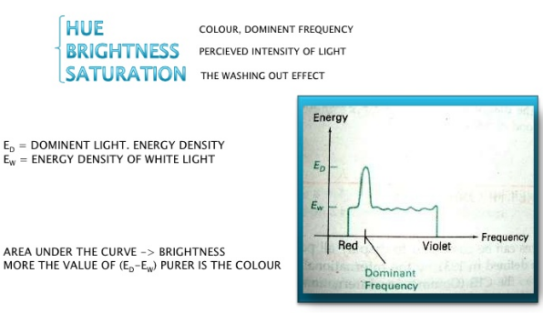

Slide 40
Color definitions
Complementary colors - two colors combine to produce white light
Primary colors - (two or) three colors used for describing other colors
A color model is an orderly system for creating a whole range of colors from a small set of primary colors.
There are two types of color models, those that are subtractive and those that are additive.
Additive color models use light to display color while subtractive models use printing inks.
Colors perceived in additive models are the result of transmitted light.
Colors perceived in subtractive models are the result of reflected light.

Slide 41
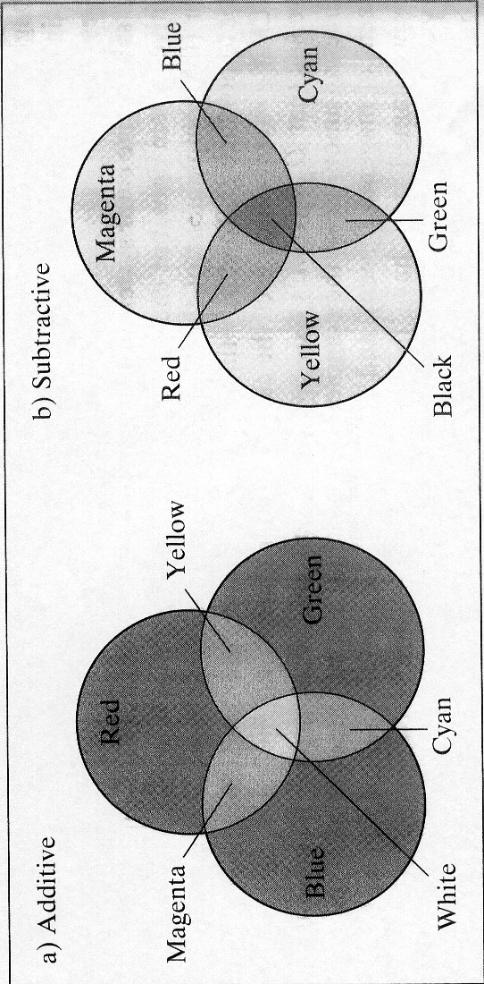
Additive mixing
pure colors are put close to each other => a mix on the retina of the human eye (cp. RGB)
overlapping gives yellow, cyan, magenta and white
the typical technique on color displays

Slide 42
Subtractive mixing
color pigments are mixed directly in some liquid, e.g. ink
each color in the mixture absorbs its specific part of the incident light
the color of the mixture is determined by subtraction of colored light, e.g. yellow absorbs blue => only red and green, i.e. yellow, will reach the eye (yellow because of addition)

Slide 43
Subtractive mixing,cont’d
primary colors: cyan, magenta and yellow, i.e. CMY
the typical technique in printers/plotters
connection between additive and subtractive primary colors (cp. the color models RGB and CMY)

Slide 44
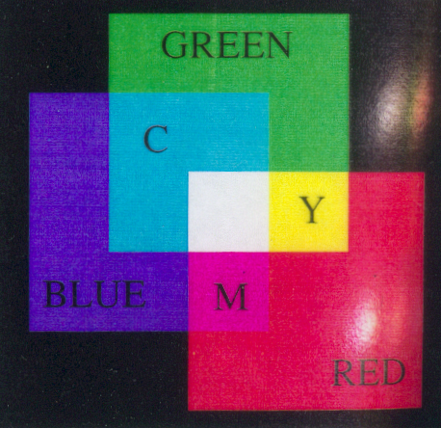
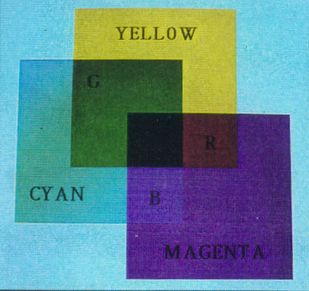
Additive/subtractive mixing
C (cyan) = G + B = W - R
M (magenta) = R + B = W - G
Y (yellow) = R + G = W – B

Slide 45
Overview of color models
The human eye can perceive about 382000(!) different colors
Necessary with some kind of classification sys-tem; all using three coordinates as a basis:
CIE standard
RGB color model
CMY color model (also, CMYK)
HSV color model
HLS color model

Slide 46
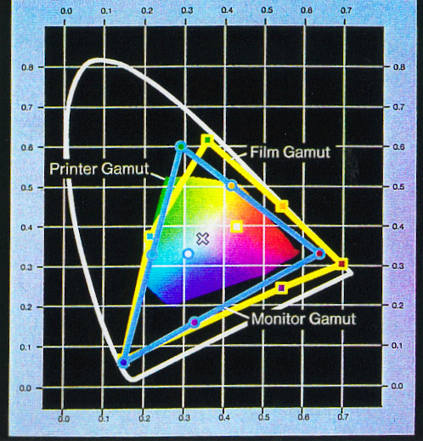
CIE standard
Commission Internationale de L’Eclairage (1931)
not a computer model
each color = a weighted sum of three imaginary primary colors

Slide 47
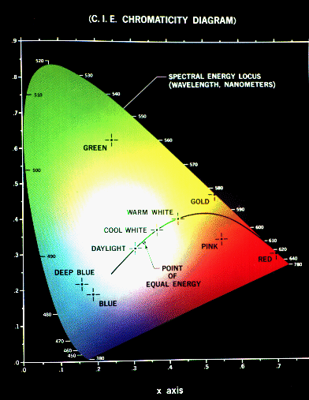
CIE primaries : Chromaticity Diagram
The tristimulus theory of colour perception seems to imply that any colour can be obtained from a mix of the three primaries, red, green and blue, but although nearly all visible colours can be matched in this way, some cannot. However, if one of the primaries is added to one of these unmatchable colours, it can be matched by a mixture of the other two, and so the colour may be considered to have a negative weighting of that particular primary.
In 1931, the Commission Internationale de l'Éclairage (CIE) defined three standard primaries, called X, Y and Z, that can be added to form all visible colours. The primary Y was chosen so that its colour matching function exactly matches the luminous-efficiency function for the human eye, given by the sum of the three curves in the below figure.

Slide 48
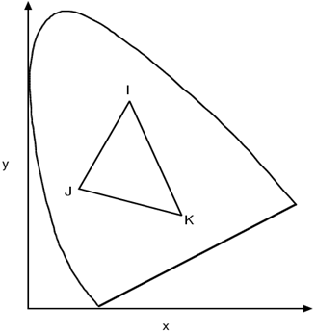
CIE primaries : Chromaticity Diagram
The CIE Chromaticity Diagram showing all visible colours. x and y are the normalised amounts of the X and Y primaries present, and hence z = 1 - x - y gives the amount of the Z primary required.
The CIE Chromaticity Diagram shows all visible colours. The x and y axis give the normalised amounts of the X and Y primaries for a particular colour, and hence z = 1 - x - y gives the amount of the Z primary required. Chromaticity depends on dominant wavelength and saturation, and is independent of luminous energy. Colours with the same chromaticity, but different luminance all map to the same point within this region.
The pure colours of the spectrum lie on the curved part of the boundary, and a standard white light has colour defined to be near (but not at) the point of equal energy x = y = z = 1/3. Complementary colours, i.e. colours that add to give white, lie on the endpoints of a line through this point.
As illustrated in below figure, all the colours along any line in the chromaticity diagram may be obtained by mixing the colours on the end points of the line. Furthermore, all colours within a triangle may be formed by mixing the colours at the vertices. This property illustrates graphically the fact that all visible colours cannot be obtained by a mix of R, G and B (or any other three visible) primaries alone, since the diagram is not triangular!
Mixing colours on the chromaticity diagram. All colours on the line IJ can be obtained by mixing colours I and J, and all colours in the triangle IJK can be obtained by mixing colours I, J and K.

Slide 49
RGB model
all colors are generated from the three primaries
various colors are obtained by changing the amount of each primary
additive mixing (r,g,b)

Slide 50
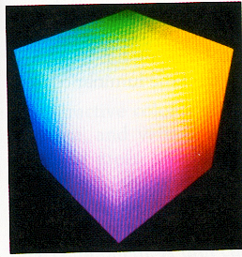
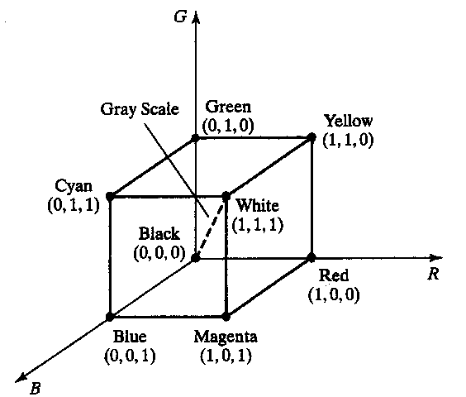
RGB model,cont’d
the RGB cube

Slide 51
CMY model
cyan, magenta and yellow are comple-mentary colors of red,green and blue, respectively
subtractive mixing
the typical printer technique

Slide 52
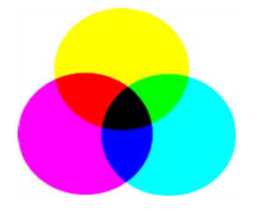
CMY model,cont’d
almost the same cube as with RGB; only black<-> white
the various colors are obtained by reducing light, e.g. if red is absorbed => green and blue are added, i.e cyan

Slide 53
RGB vs CMY
If the intensities are represented as 0≤r,g,b≤1 and 0≤c,m,y≤1 (also coordinates 0-255 can be used), then the relation between RGB and CMY can be described as:

Slide 54
CMYK model
For printing and graphics art industry, CMY is not enough; a fourth primary, K which stands for black, is added.
Conversions between RGB and CMYK are possible, although they require some extra processing.

Slide 55
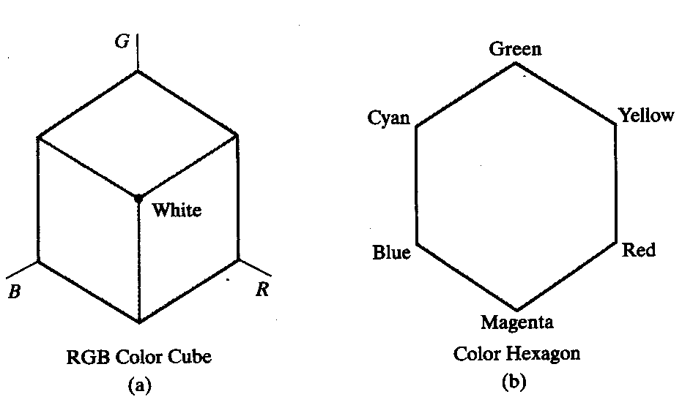
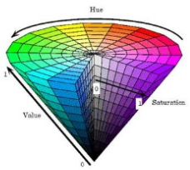
HSV model
HSV stands for Hue-Saturation-Value
described by a hexcone derived from the RGB cube

Slide 56
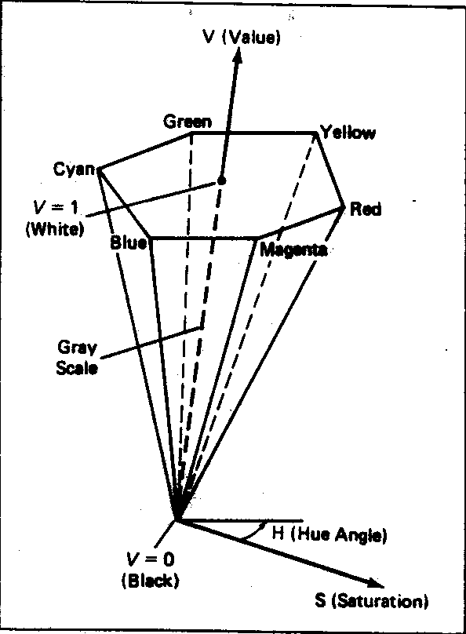
HSV model,cont’d
Hue (0-360°); ”the color”, the dominant wave-length
Saturation (0-1); ”the amount of white”
Value (0-1); ”the amount of black”

Slide 57
HSV
HSV Color Model Hue, Saturation, Value or HSV is a color model that describes colors (hue or tint) in terms of their shade (saturation) and their brightness (value). HSV color model is based on polar coordinates; Developed in the 1970s for computer graphics applications, HSV is used today in color pickers, in image editing software, and less commonly in image analysis and computer vision.
HSV Color Model • Hue (H), the color type (such as red, green). It ranges from 0 to 360 degree, with red at 0 degree, green at 120 degree, blue at 240 degree and so on. The two representations rearrange the geometry of RGB in an attempt to be more intuitive and perceptually relevant ,based on the color wheel.
HSV Color Model • Saturation (S) of the color ranges from 0 to 100%. Also sometimes, it called the "purity". The lower the saturation of a color, the more "grayness" is present and the more faded the color will appear. • Value (V), the Brightness (V) of the color ranges from 0 to 100%. It is a nonlinear transformation of the RGB color space. Note that HSV and HSB are the same.

Slide 58
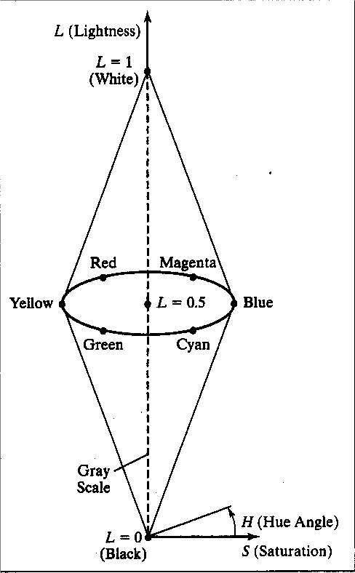
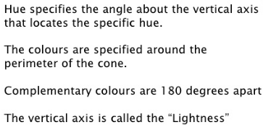
HLS model
Another model similar to HSV
L stands for Lightness

Slide 59
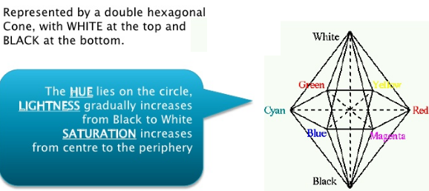

Slide 60
Color models
Some more facts about colors:
The distance between two colors in the color cube is not a measure of how far apart the colors are perceptionally!
Humans are more sensitive to shifts in blue (and green?) than, for instance, in yellow

